Slide 1
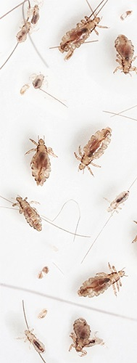
Epidemic Typhus

Slide 2
Gaol Fever
Epidemic Typhus Fever
War Fever
Jail Fever
Typhus exanthematicus

Slide 3
History
1489: Arrival in Europe
Soldiers returning from Cyprus
1557-59: Outbreak in England
Killed 10% of the population
Poor sanitation
1880
Typhoid bacillus identified
Notes:
Typhus arrived in Europe in 1489 with soldiers who had been fighting in Cyprus. An outbreak in 1557-59 killed about 10% of the English population. Typhus mainly killed poor people living in places where sanitary conditions were very bad. It was also a common disease in prisons and for this reason typhus was also known as gaol fever (gaol is an Old English word for jail). The typhoid bacillus was first identified in 1880.

Slide 4
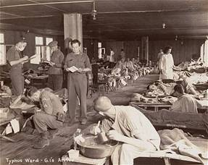
History
17th-19th century
Epidemics in Europe as a result of war, disaster, or in prisoners
1909: Transmission by lice
1917-1925: Russia
Estimated 25 million cases
End of WWII
DDT used for control
Vaccine developed
Notes:
Epidemics of typhus occurred throughout Europe from the 17th to the 19th centuries. Widespread epidemics occurred during the Napoleonic Wars and the Irish Potato famine of 1846 to 1849. Charles Jules Henri Nicolle a Frenchman received the Nobel Prize for his work on typhus in 1928. He demonstrated that the transmission of typhus was by the human body louse. During World War I the disease caused three million deaths in Russia and more in Poland and Romania. Later epidemics were avoided due to the discovery of DDT. A vaccine was also developed in World War II, and today epidemics mainly occur in Eastern Europe, the Middle East and parts of Africa where living conditions and hygiene are poor. Image: A U.S. soldier is demonstrating DDT-hand spraying equipment while applying the insecticide. The use of DDT increased enormously on a worldwide basis after WWII, because of its effectiveness against the mosquito that spreads malaria and lice that carry typhus. The World Health Organization claims that the use of DDT saved 25 million lives. Decline in the use of DDT began the 1970’s and was attributed to a number of factors including increased insect resistance, development of more effective alternative pesticides, growing public and use concern over adverse environmental side effects and increased government restriction. The lower photo shows a typhus ward after the liberation of the prison camps in WWII.

Slide 5
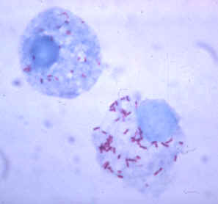
The Rickettsiae
Gram-negative, obligate intracellular parasite
Pleomorphic ~ 1 mkm in length
LPS-complex!

Slide 6
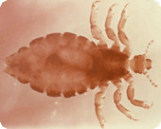
Three types of lice:
Head lice: Pediculus humanus capitis (2-3 mm long)
Body lice: Pediculus humanus humanus (2.3-3.6 mm.long)
Pubic lice (crabs): Phthirus pubis (1.1-1.8 mm long)

Slide 7
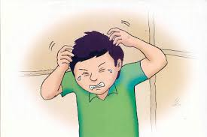
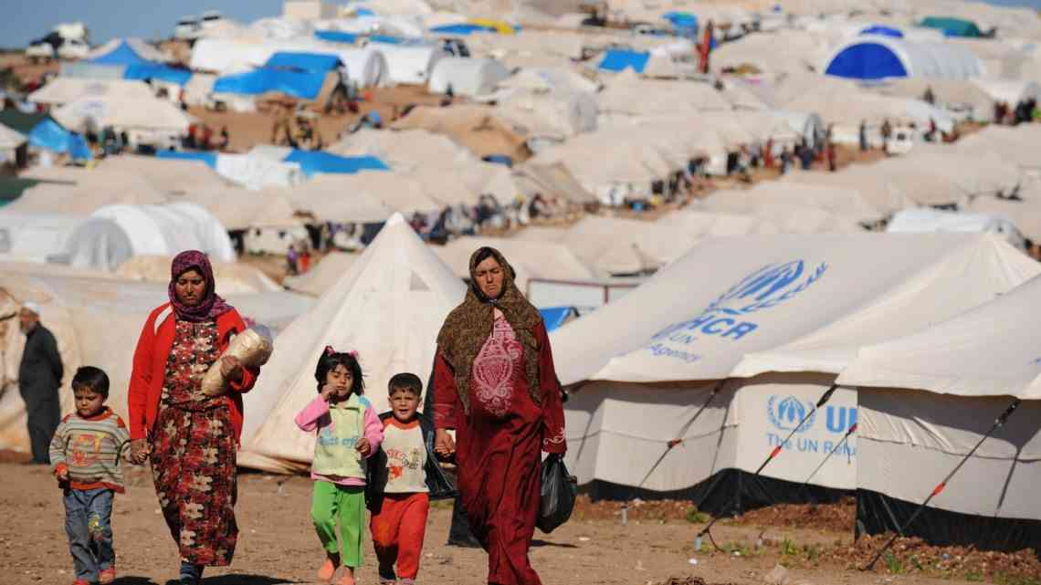
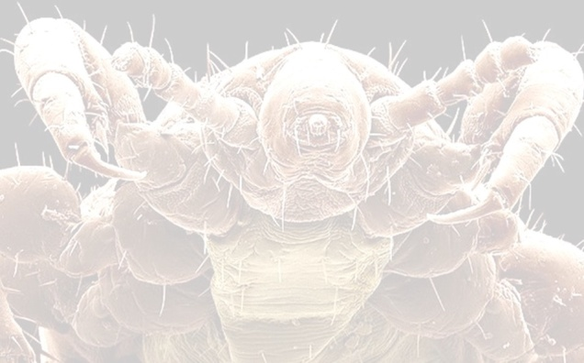
Epidemiology
Typhus epidemics usually occur where louse populations are high. Infections are typically seen in populations living in unsanitary and crowded conditions.
Outbreaks are often associated with wars, famines, floods and other disasters. Most epidemics occur during the colder months.
The disease is most often fatal for people who are elderly, malnourished, or physically exhausted.

Slide 8
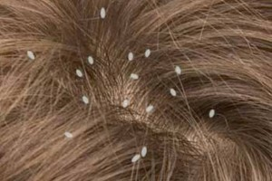
Epidemiology
Antroponossis
The source of infection – person with epidemic typhus or Brill-Zinsser disease.
2-3 last days of incubation period
All fever period (16-18 days)
2-8 days after fever
BUT
Lice (2 weeks)
No epidemic process without lice(s).

Slide 9
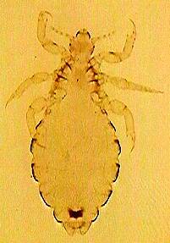
The Vector
Order Anoplura
Life cycle (egg to egg) takes 22-28 days
Eggs hatch in 5-9 days
Prefers 82-86ºF -> remains on human host until death or high fever (can live 5-8 days away from host)
Prefers areas in direct contact with clothing -> neck, armpits, crotch
Lays eggs on clothing

Slide 10
Pathogenesis
Enter through skin -> bloodstream
Infect endothelial cells by inducing phagocytosis and escaping phagolysosome -> replicate in cytosol
R. prowazekii escapes by cell lysis
May lyse cells extracelluarly via phospholipase A production -> increased vascular permeability and hypotension

Slide 11
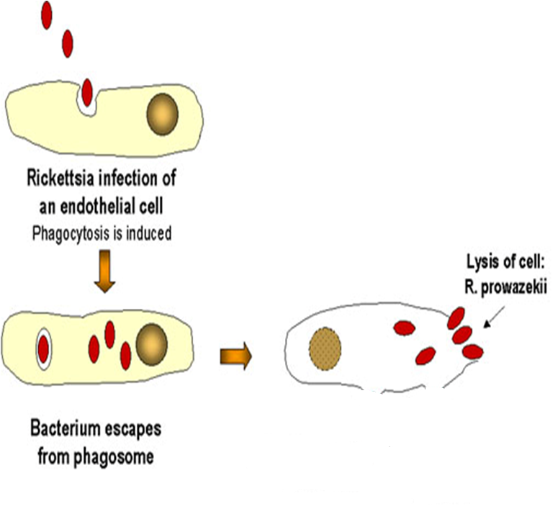
Triangle
thrombus formation
destruction of the bloodvessele’s wall
cellular proliferation

Slide 12
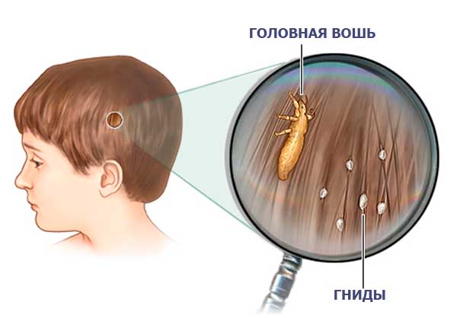
Clinical picture
Incubation period 5-25 days
Initial period 4-5 days
Fastigium stage 4-10 days
Convalescence stage from the normal T
Photophobia with considerable conjunctival injection (“rabbit’s eyes”) and petechial rash on conjunctiva (symptom of Kjary-Aucyne) is typical. Before the rash appearance enanthema (small hemorrhages) on the basis of uvula is marked (Rosenberg’s symptom).

Slide 13
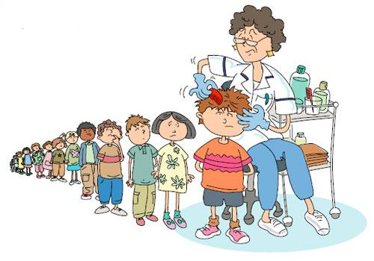
Prognosis
Case fatality rate
1% with antibiotic treatment
Up to 100% without treatment
Increases with age
Vacctination – vaccine type E 0.25 ml – 1 year

Slide 14
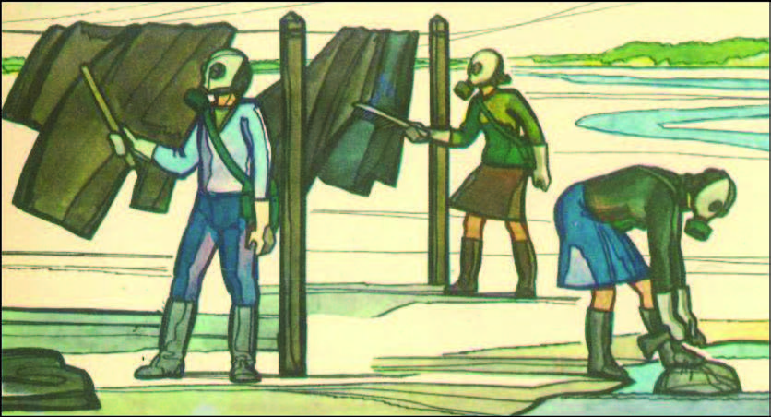
Prevention and Control
Treat clothing and bedding
160 degrees for one hour
Chemical control
Permethrin (0.5%) temephos (2%), popoxur (1%) and carbaryl (5%)
Biosafety level 3
Handling infectious materials, lice, carcasses
Proper hygiene
Notes:
Prevention and control measures for typhus include measures for treating clothing and bedding to kill the bacteria and the infective lice. Expose clothing to 160 degrees one hour. Chemical control measures are also affective. Use Permethrin (0.5%), Temephos (2%), Popoxur (1%) and Carbaryl (5%). These chemicals can either be dusted on to areas or the clothing and bedding can be treated. Lice and flying squirrels infected with typhus should also be handled using biosafety level 3 requirements. Proper hygiene should also be followed to prevent the spread of body lice.

Slide 15
Epidemic Typhus as Biological Weapon
Readily available
Stable in lice feces for weeks
Aerosolized
World Health Organization
50kg of aerosolized typhus
City of 5 million would result in
125,000 people sick
8,000 deaths

Slide 16
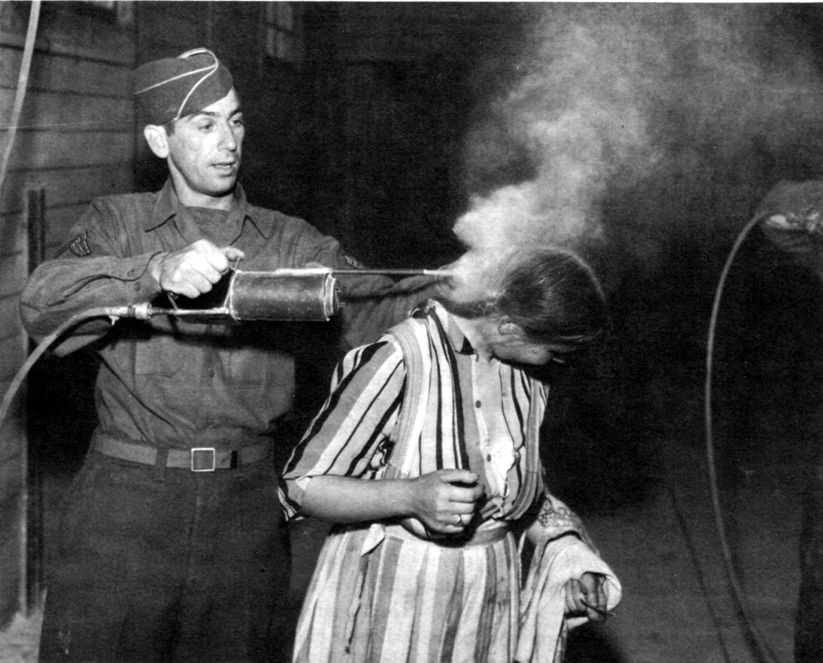
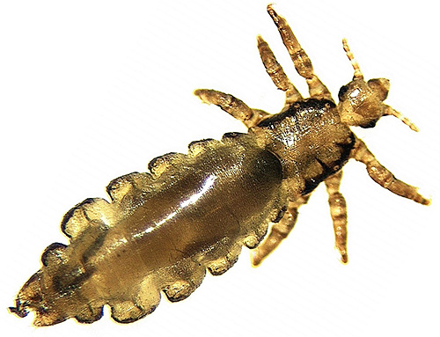
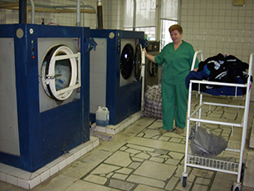

Slide 17
The End

